Slide 1
EUROPEAN INNOVATIVE TEMPERATURE, HUMIDITY AND PRESSURE SENSORS MANUFACTURER
Company presentation

Slide 2
RGP CY – Embracing Modern Trends
RGP CY has been manufacturing temperature sensors, temperature, humidity and pressure transducers, as well as capillary thermostats for heating, ventilation and air conditioning systems since 2016.
Our production facility is located in Cyprus. Together with our trusted long-term partners, we are able to produce products of the highest quality that surpass modern requirements for reliability, functionality, and ease of use.
Sensors are widely utilized by manufacturers of ventilation systems, boiler equipment and engineering companies.

Slide 3
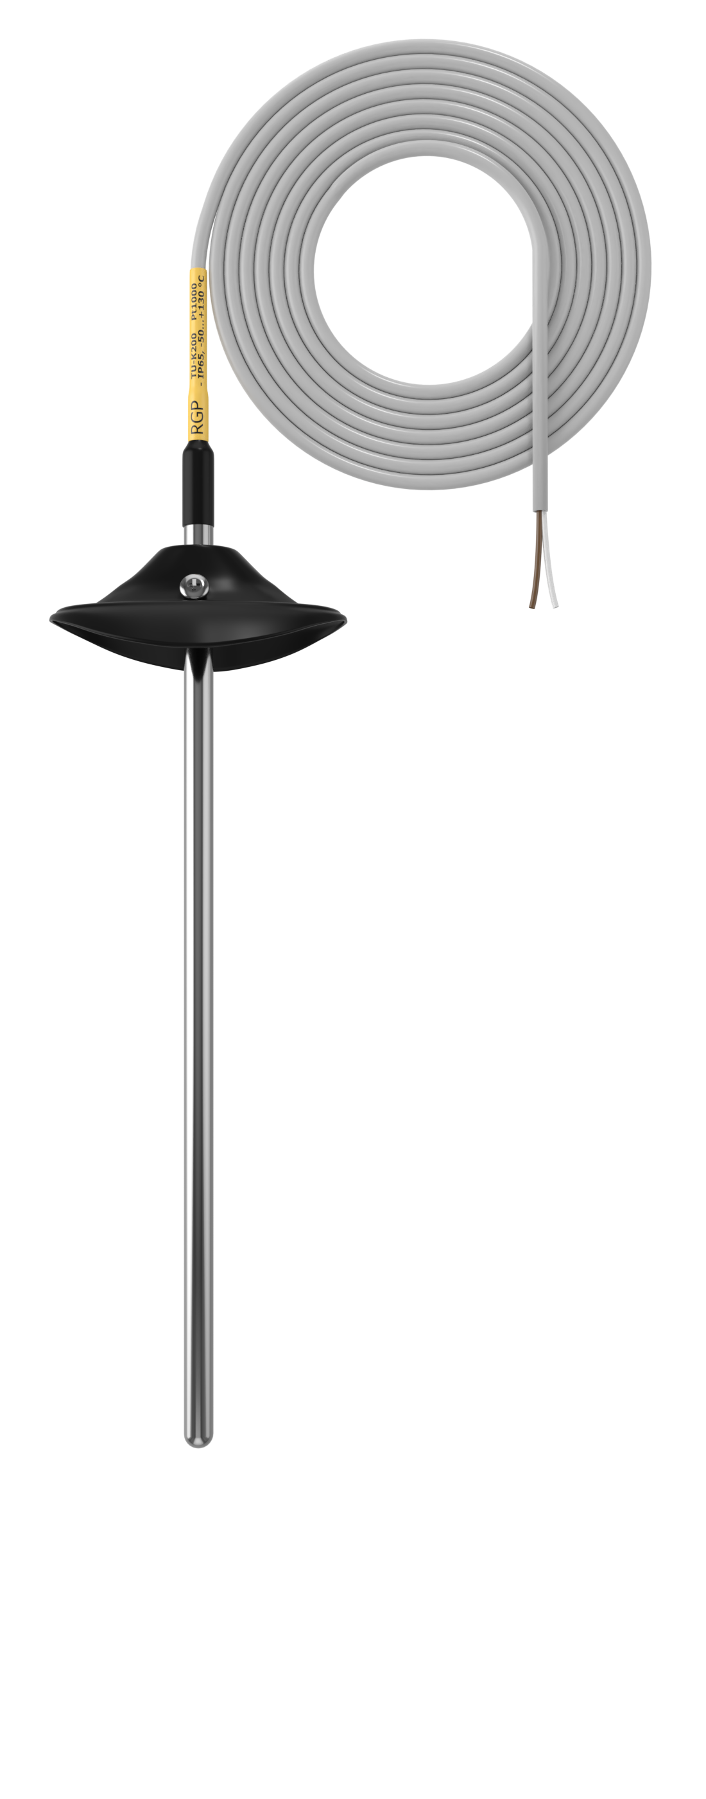
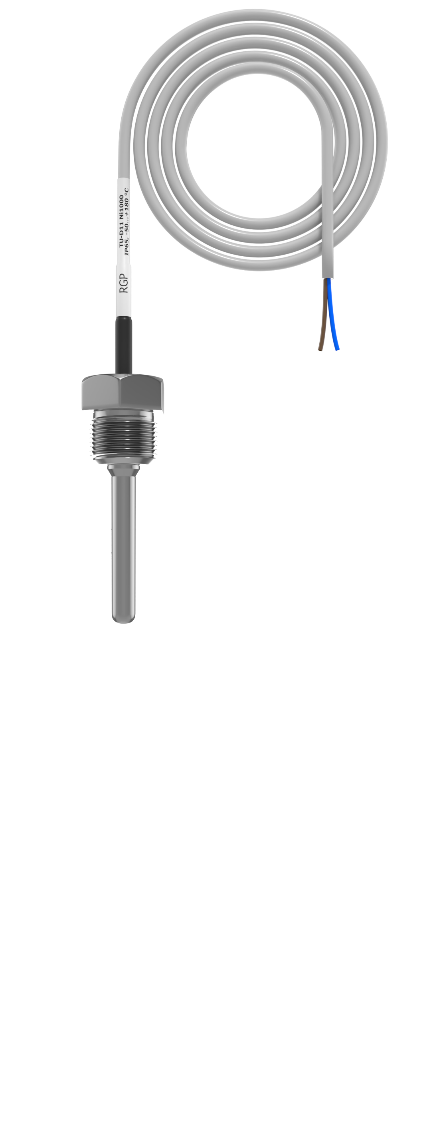
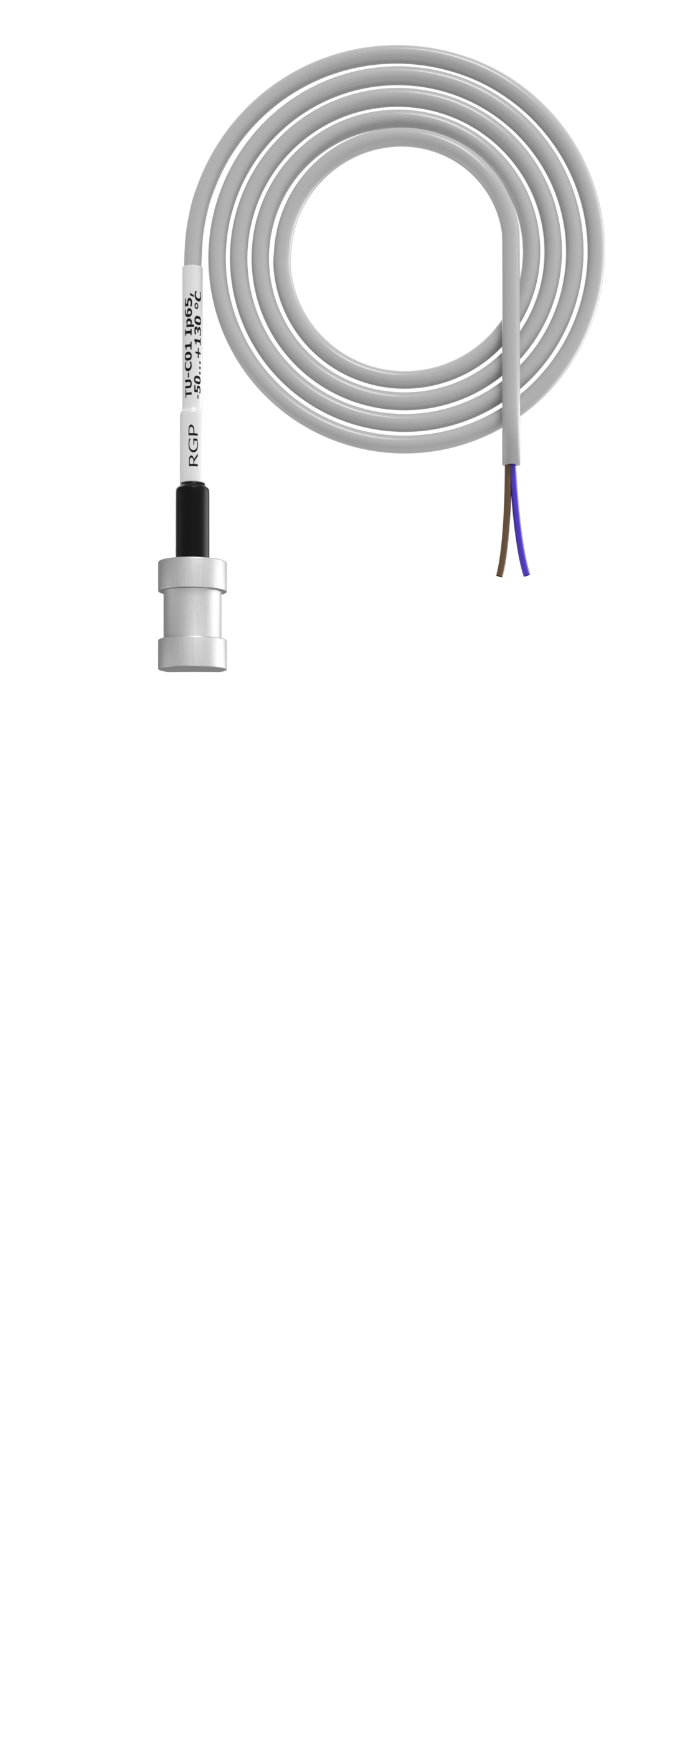
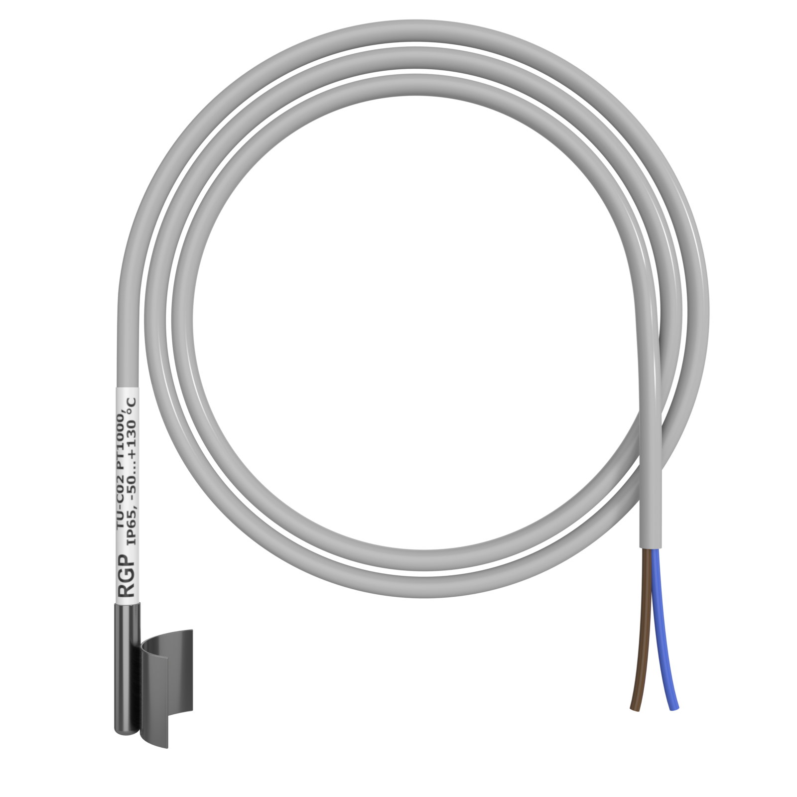
Cable temperature sensors
Cable temperature sensors are used to measure temperature in channels of the HVAC systems and widely used by manufacturers of ventilation systems, boiler equipment and engineering companies.
Key features:
High-precision: (0,3°C or 1%)
Measuring elements: Pt100, Pt1000, Ni1000, NTC10k.
Measuring range: -50…+130°C
Working environment: -40…+70°C
Protection class IP65-IP67
Lifetime: 10 years
Tested individually (100% control)
5-years warranty
Material: AISI, PVC, PC, ABS
Датчики влажности

Slide 4
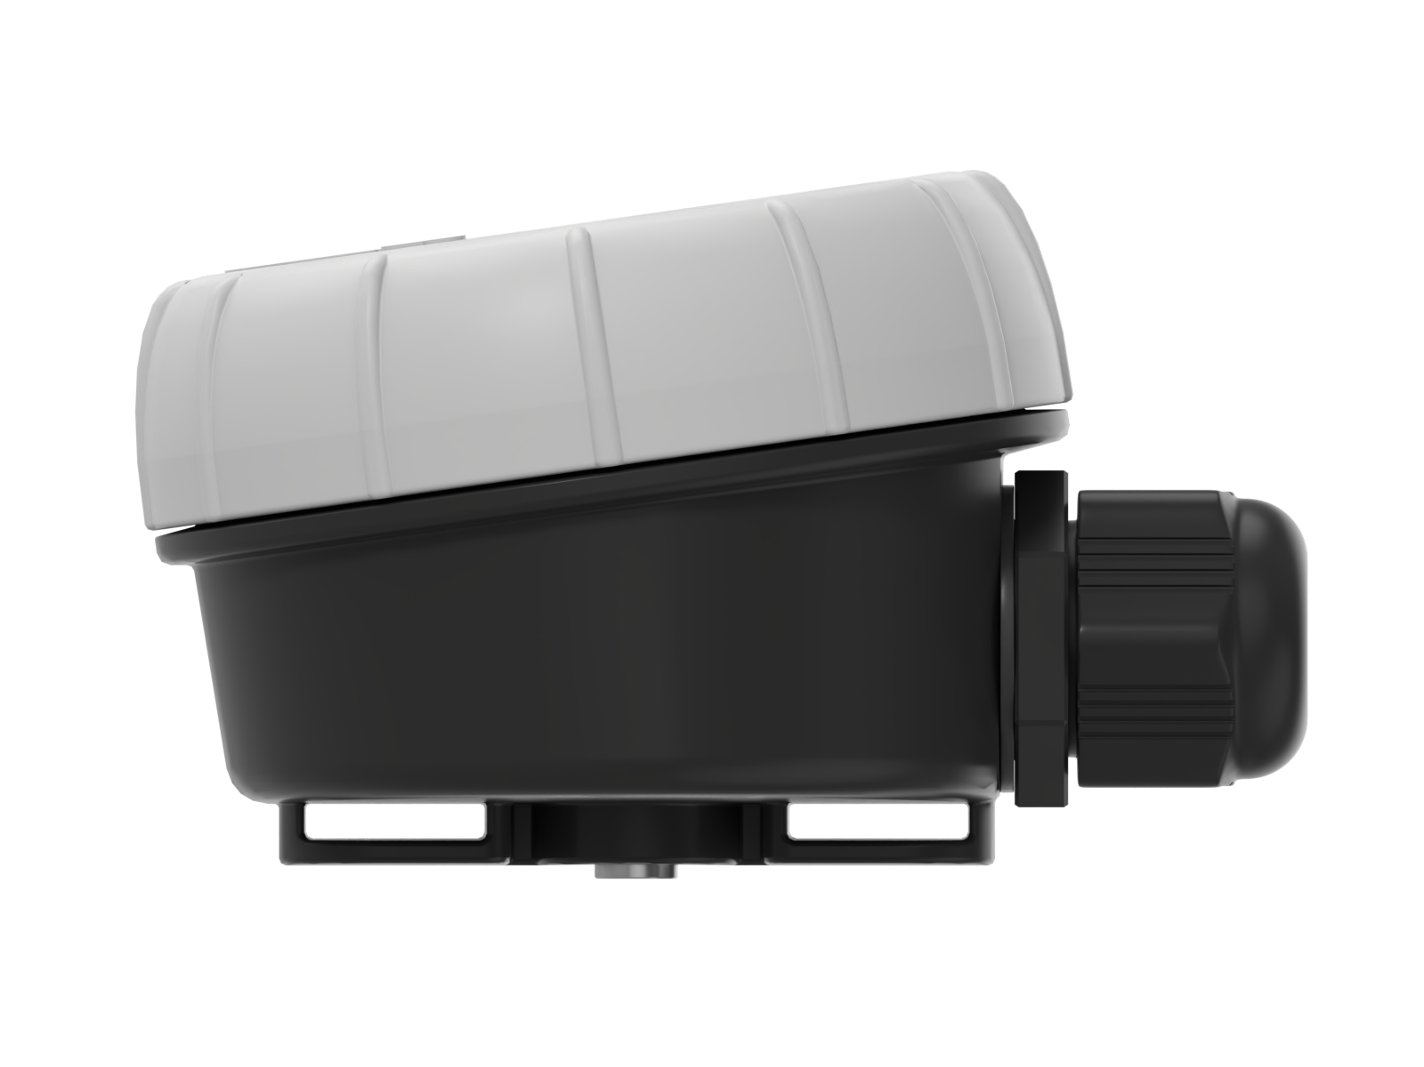
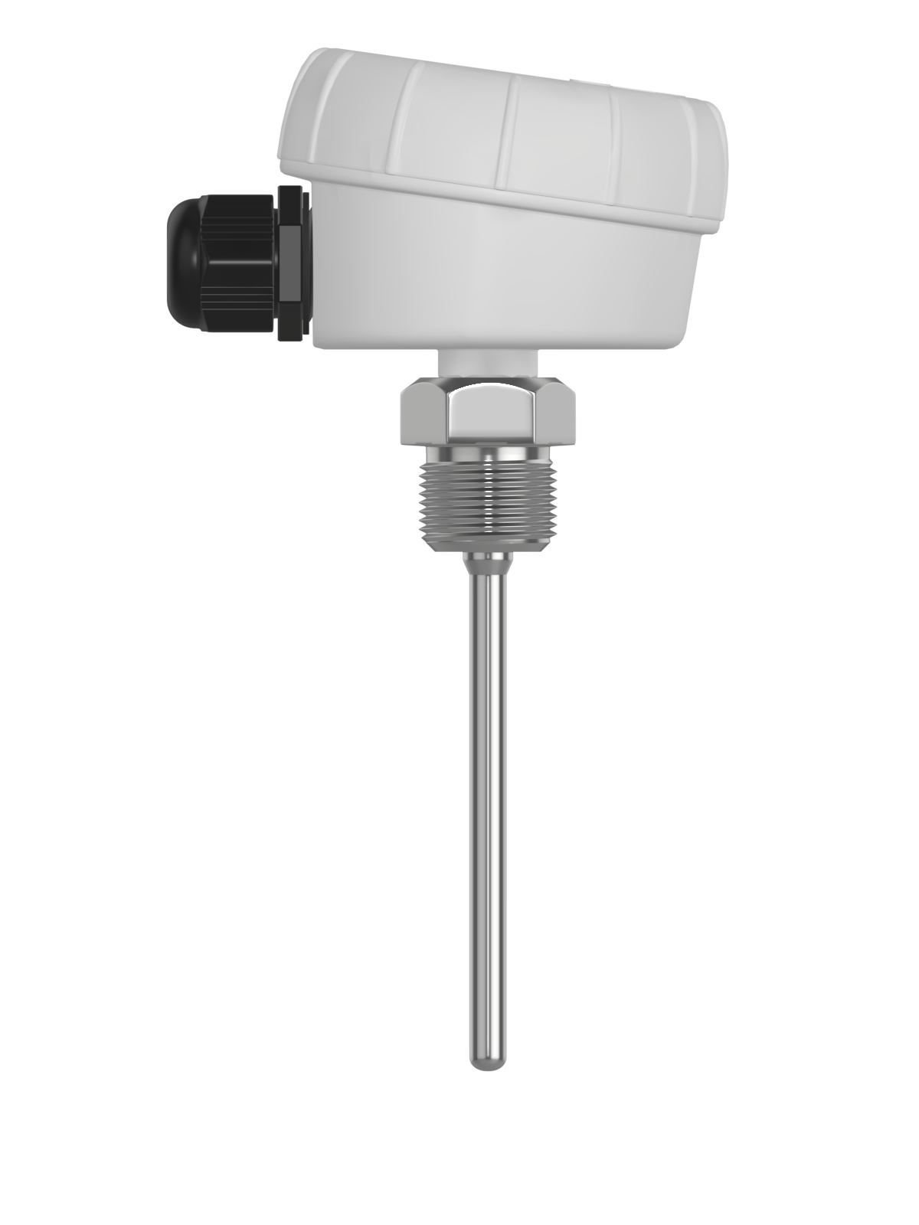
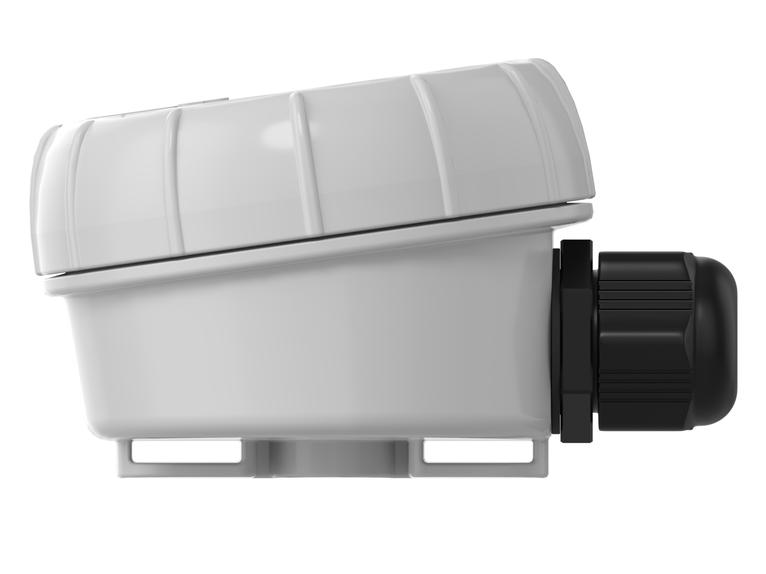
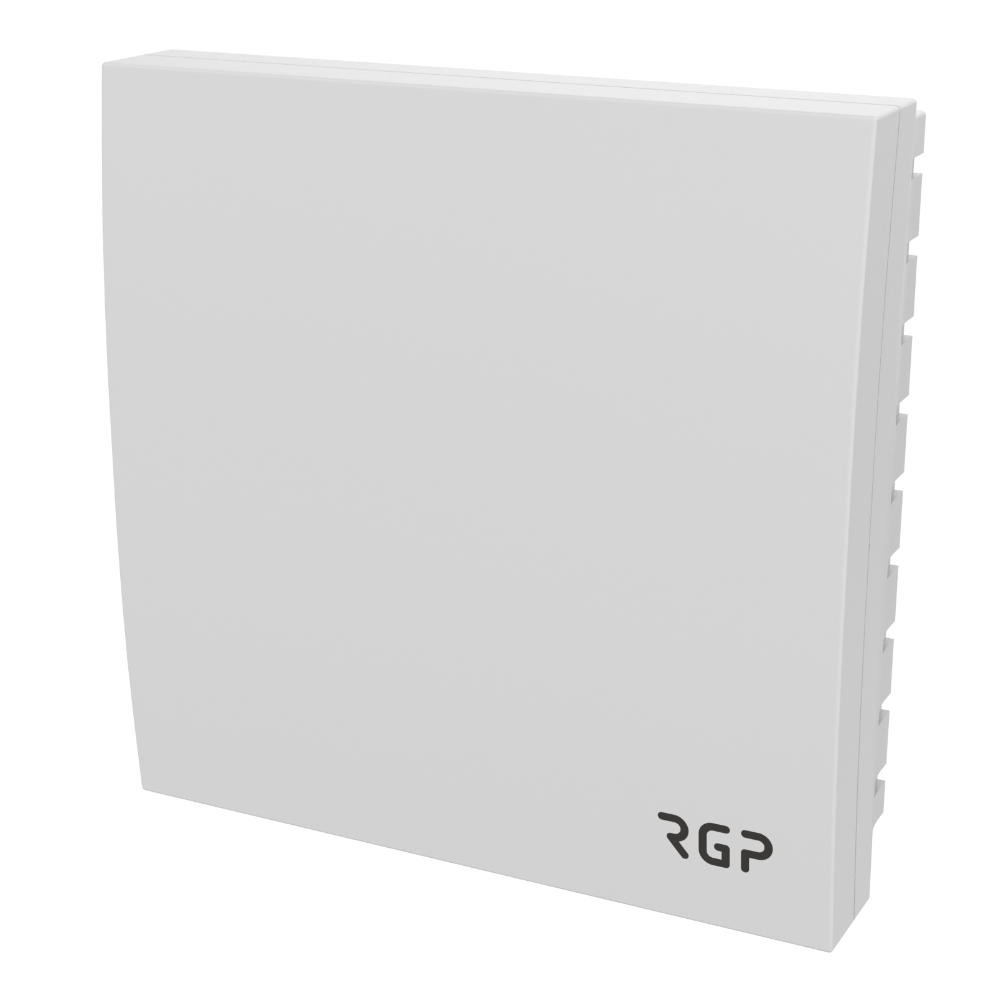
Temperature sensors.
Temperature sensors are used to measure temperature in channels of the HVAC systems and widely used by manufacturers of ventilation systems, boiler equipment and engineering companies.
Key features:
High-precision: (0,3°C or 1%)
Measuring elements: Pt100, Pt1000, Ni1000, NTC10k.
Measuring range: -50…+130°C
Working environment: -40…+90°C
Protection class IP31, IP65, IP67
Lifetime: 10 years
Tested individually (100% control)
5-years warranty
Material: AISI, ABS
Датчики влажности

Slide 5
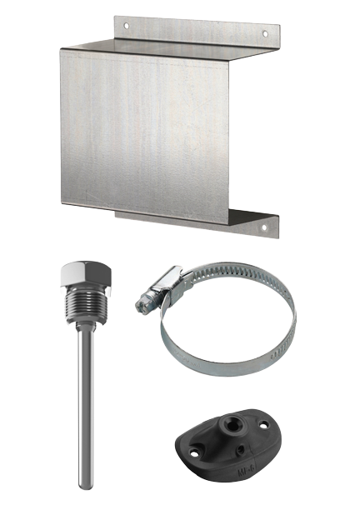
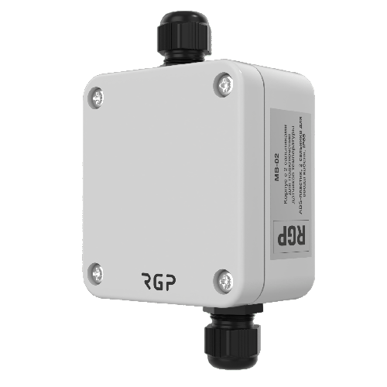
Accessories
Stainless steel immersion sleeves are offered with a G1/2 threaded connection. These sleeves deliver dependable shielding for the temperature sensor's measuring component in environments with temperatures reaching up to 600 °C and pressures ranging from 10 to 25 bar. The sleeves are available in probe lengths spanning from 50 to 200 mm.
The mounting flanges are used for affixing temperature sensors, humidity sensors, and duct thermostats to air ducts in ventilation systems. These flanges have a hole diameters of 6, 7, 8, 10, and 12 mm. Manufactured from robust polymer material, the flanges exhibit resilience to temperatures up to +100 °C, thereby ensuring accurate and reliable sensor installation.
The mounting box is intended for connecting cable temperature sensors. The housing of the box is constructed from ABS-plastic, and it possesses an IP65 protection rating. It has 2 glands.
The galvanized steel screen is used to protect outdoor air temperature and humidity sensors against precipitation, sunlight, and potential mechanical harm. This screen guarantees precise measurement of ambient temperature by preventing direct sunlight interference. The screen's dimensions measure 184 x 180 x 80 mm.
Датчики влажности

Slide 6
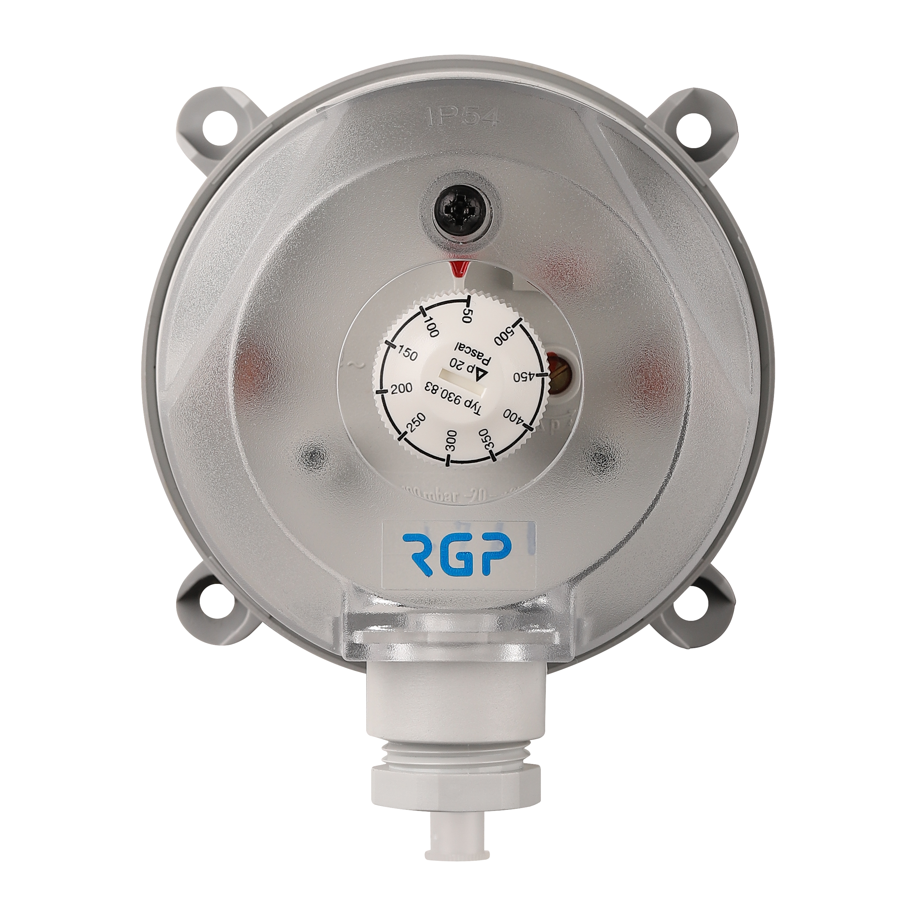
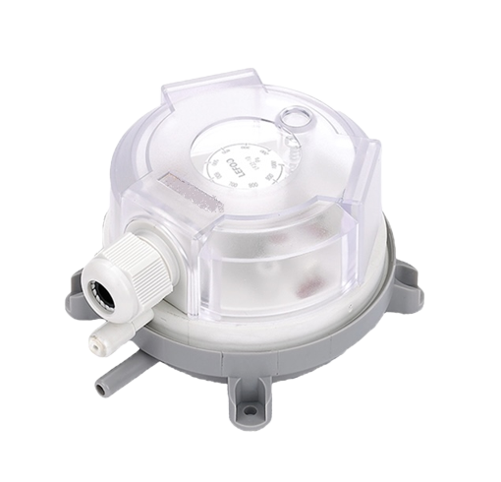
Air differential pressure switch
Air differential pressure switches are primarily used in heating and ventilation applications. These pressure switches offer manual adjustability within a range of 20 to 5000 Pa, with a tolerance of 10%.
Key features:
Pressure range 20 - 2500 Pa
Differential 10 - 150 Pa
Measuring range: -50…+130°C
Working environment: -20…+80°C
Protection class IP54, IP65
RGP CY has developed the design for these switches and they are manufactured in China by a trusted long-term partner. The manufacturing process adheres to top international standards to ensure highly reliable, durable and functional characteristics of the switches.
Overall, our air differential pressure switches are designed for heating and ventilation applications, offering adjustable pressure settings, wide operating temperature range, and compliance with international requirements to ensure their reliability and usability.
Датчики влажности

Slide 7
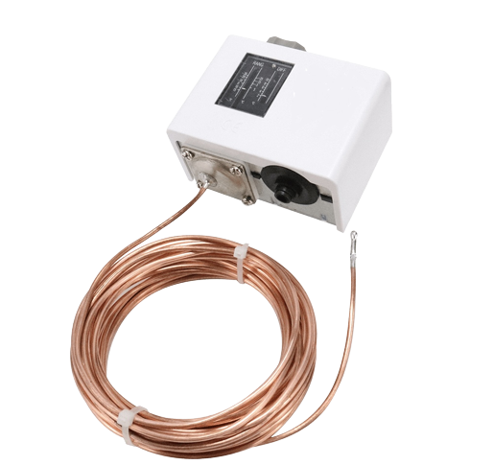
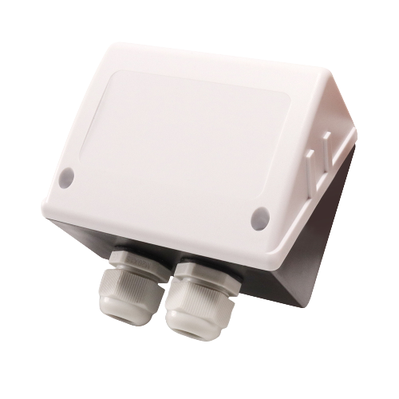
Temperature switch.
The temperature switch serves two main purposes: protecting the ventilation unit from freezing during winter and controlling the temperature in ventilation, heating and air conditioning systems. It features a customized brass capillary that can reach a length of up to 11.5 meters. The switch is primarily designed with an IP30 protection class, but this can be upgraded to IP42 by using a protection cover or to IP55 by using a protection case. It is being delivered preset for actuation at 7°C.
Key features:
Media temperature range: -40°C to +120°C
Environment temperature range: -40°C to +65°C
Setting range: -30°C to +15°C
Hysteresis setting range: 2°C to 8°C
Capillary length options: 1 to 11.5 meters
The temperature switch is designed by RGP CY and manufactured in China by a trusted long-term partner. The design and manufacturing process adhere to top international requirements, ensuring the switch possesses highly reliable, durable, and usable characteristics.
Датчики влажности

Slide 8
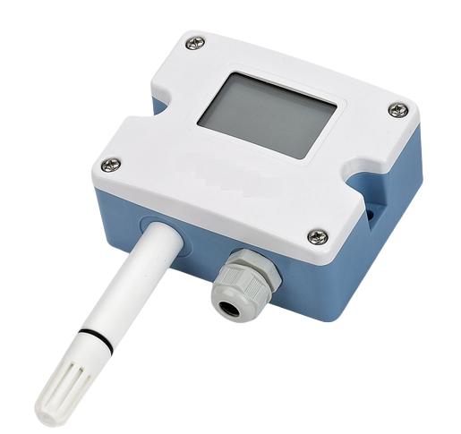
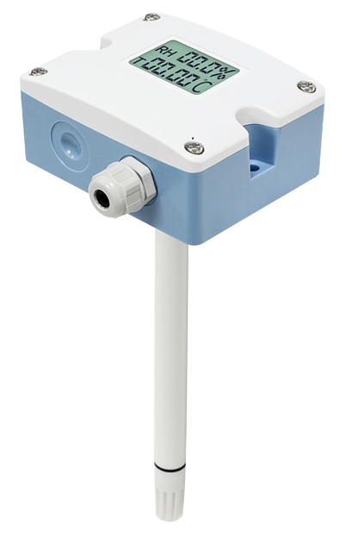
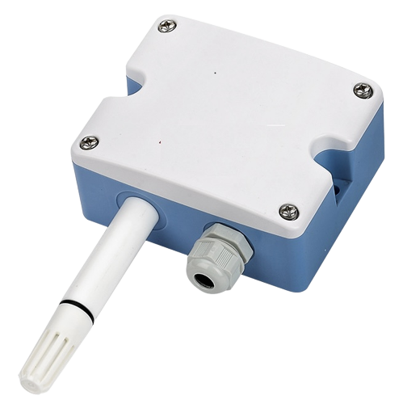
Temperature and humidity transmitter
The temperature and humidity transmitter is specifically designed for industrial applications. It is available in three installation methods: wall-mounted, duct type, and split. The transmitter offers three output modes: current, voltage and RS485, allowing flexibility for different system requirements. The device can be produced with or without an LCD display.
Key features:
Relative humidity measuring range: 0% to 100% Rh
Temperature measuring range: -20°C to +60°C
Working environment: -20°C to +60°C, 5% to 95% relative humidity
Protection class: IP65
The transmitter is designed by RGP CY and manufactured in China by a trusted long-term partner. The design and manufacturing processes adhere to top international requirements, ensuring the transmitter possesses highly reliable, durable, and usable characteristics.
Датчики влажности

Slide 9
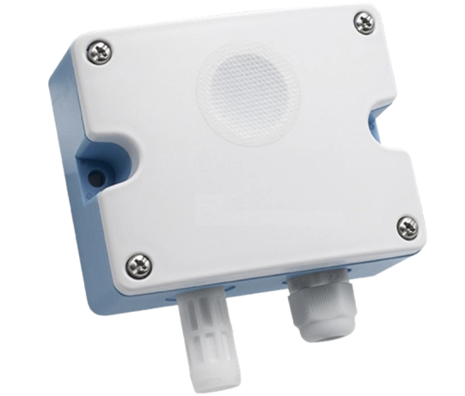
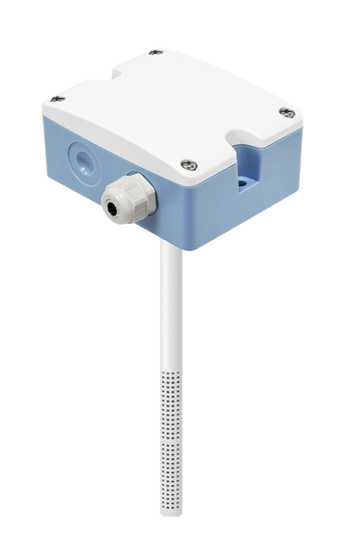
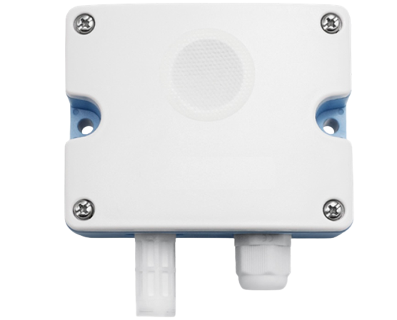
Air quality transmitters.
The CDS201 carbon dioxide transmitter is suitable for indoor air quality testing, air conditioners, air purifiers, vegetable greenhouses and other applications that require precision gas measurement and control. Depending on the model, the transmitter provides measurement ranges of 0 to 2000, 5000 or 10000 ppt. It operates within a temperature range of -10°C to +50°C and a humidity range of 0% to 80%.
The CDS202 duct carbon dioxide transmitter is specifically designed for use in ventilation systems. It measures CO2 concentration up to 2000 or 5000 ppt and operates at temperatures ranging from 0°C to +50°C with a humidity range of 0% to 80%.
The CMS202 carbon monoxide transmitter is used for controlling ventilation in closed parking lots, vehicle maintenance, and inspection workshops. It is available in two models that measure CO concentration up to 500 or 1000 ppt. The transmitter operates within a temperature range of -10°C to +50°C and a humidity range of 15% to 90%.
All these transmitters are designed by RGP CY and manufactured in China by a trusted long-term partner. The design and manufacturing processes adhere to top international requirements, ensuring the transmitters possess highly reliable, durable, and usable characteristics.
CDS201
CDS202
CMS202

Slide 10
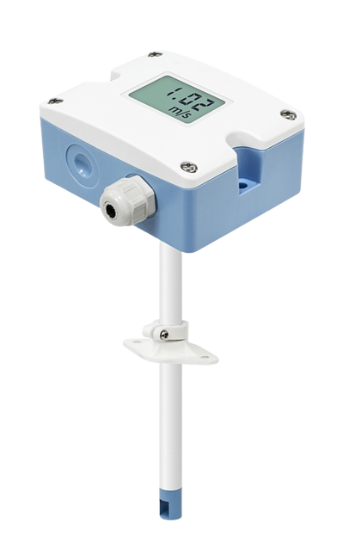
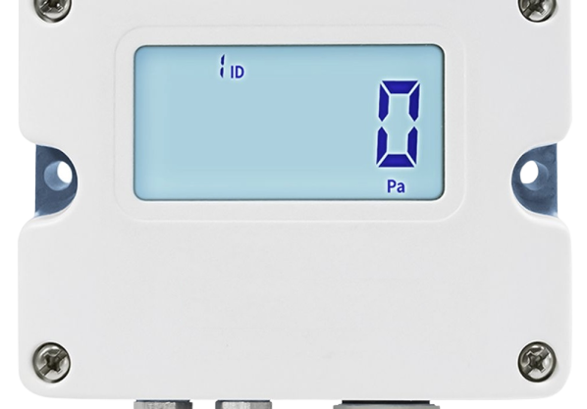
Air flow transmitters.
AFS10 air velocity transmitter is specifically designed for measuring wind speed in HVAC systems, pipeline air volume measurement, process and environmental control and various other application scenarios. It is characterized by high measurement accuracy, a wide measurement range, good stability, and strong environmental adaptability.
Working temperature: -10°C to +60°C
Environment temperature: -20°C to +80°C
Protection class: IP65 (main unit), IP20 (probe)
DPT (differential pressure transmitter) is engineered for building automation in the HVAC/R industry, as well as pressure and flow monitoring, and low differential pressure testing in industrial applications. The instrument can operate within a pressure range of up to 10,000 Pa and can be optionally equipped with an LED display.
Working temperature: -10°C to +60°C
Environment temperature: -10°C to +70°C
Protection class: IP54
Both transmitters, AFS10 and DPT are designed by RGP CY and manufactured in China by a long-term partner in accordance with top international requirements. The aim is to achieve highly reliable, durable, and usable characteristics in the transmitters.
.
DPT
AFS10

Slide 11
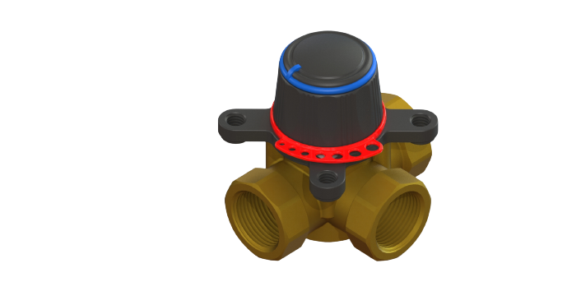
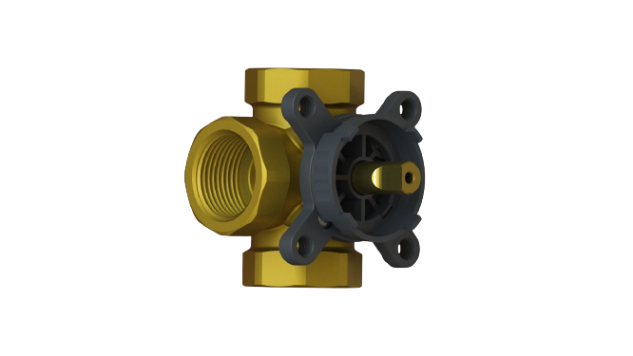
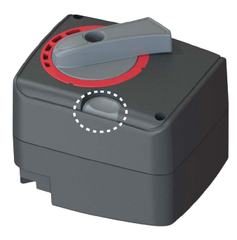
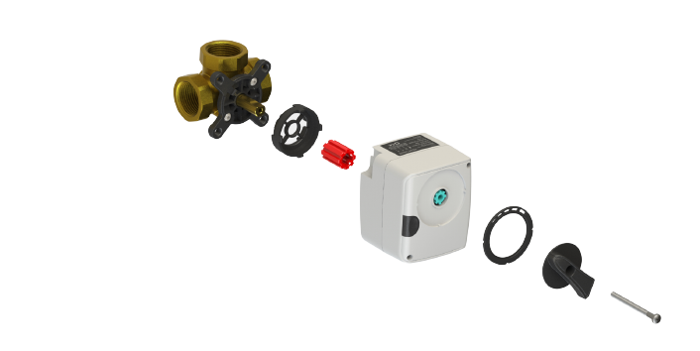
Mixing valves and actuators
3-way rotary mixing valves are specifically designed for use in heating systems, such as radiator systems, underfloor heating, radiant panels, mixing circuits, heat pumps, HVAC systems, and solar heating systems. These valves can be used with both RGP and other manufacturers actuators, provided that the appropriate adapters are used.
Working temperature: -10°C to +110°C
Working pressure: 10 Bar
Nominal diameter: DN 15 – 50
KVS (flow coefficient): 0.4 – 40 m3/h
Connection: G1/2 - G2.0
The actuators designed for the mixing valves are used to control the rotary mixing valves with a torque of up to 6 Nm. They can be controlled by 3-point control signals or a 0-10V (2-10V) proportional signal.
Temperature range: -5°C to +50°C
Torque: 6 Nm
Actuator speed: 120 s, 60 s, or 60/120 s
These products are designed by RGP CY and manufactured in China.

Slide 12
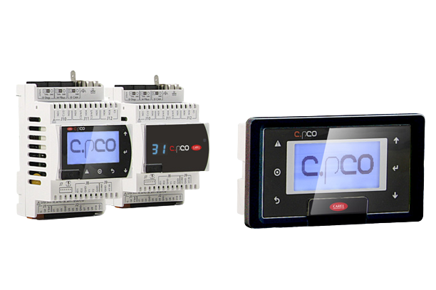
Programmable electronic controller
The c.pCOMini is a programmable electronic controller specifically designed for air-conditioning, heating, refrigeration, and HVAC/R applications. It offers a high degree of flexibility, allowing for customized solutions based on customer requirements. The controller utilizes the c.suite software developed by Carel, which provides maximum programming flexibility and the ability to create application programs tailored to specific needs.
Here are the key features of the c.pCOMini controller:
Integrated Ethernet interface
Integrated USB interface
BMS (Building Management System) and Field bus connectivity
Flexible input/output options
The c.pCOMini controller is equipped with three serial ports, a CANbus port, and an Ethernet port for communication with pGD1 family terminals and other devices. It offers a multifunctional interface, enabling seamless interoperability with third-party systems and facilitating cost savings.
The c.pCOMini controller is developed and manufactured by Carel in Italy. It is known for its high efficiency, user-friendliness, and flexibility, making it a reliable choice for various HVAC/R applications.

Slide 13
RGP CY in figures
15
YEARS OF EXPERIENCE
We have accumulated extensive experience in the HVAC industry. This long-standing expertise has enabled us to gain in-depth knowledge of our customers' requirements and effectively meet their needs.
500
ITEMS PRODUCT RANGE
RGP CY specializes in the production of a comprehensive range of sensors essential for the automation of engineering systems. Our product portfolio includes thermostats, differential pressure switches, and a wide range of accompanying accessories. We are dedicated to providing high-quality sensor solutions that meet the demands of various applications in the field of engineering system automation.
100%
FINAL INSPECTION
We conduct a thorough final inspection of each and every product to ensure 100% quality assurance. This meticulous inspection process, combined with our extensive manufacturing experience, instills complete confidence in the quality of our products. We are committed to delivering only the highest quality products to our customers, and our final inspection plays a crucial role in achieving that goal.
100%
CUSTOMERS SATISFACTED
In 2022 alone, we successfully delivered over 150,000 temperature and humidity sensors, thermostats, and differential pressure switches to our valued customers. This significant number of deliveries is a testament to the trust and satisfaction that our customers have in our products.

Slide 14
RGP SENSORS KEY ADVANTAGES
WIDE RANGE OF PRODUCTS
RGP CY offers over 500 items to meet diverse customer needs in the HVAC industry. We are committed to customer satisfaction and continuously expanding our product range.
DEEP EXPERTISE
Over 15 years of HVAC industry experience enables us to anticipate and proactively address our customers' wishes and needs.
DELIVERING RAPIDLY
Our efficient manufacturing system and established logistics ensure that we are a fast and reliable partner for all our customers.
HIGHLY RELIABLE
Our production process includes a thorough 100% final inspection, ensuring that we have complete confidence in the quality of our products, backed by our extensive manufacturing experience.
DESIGNED AND PRODUCED IN EUROPE
We manufacture our sensors at our own facility in Cyprus, while our other products are designed by our engineers in our Cyprus design laboratory and produced with our trusted long-term partners in China.

Slide 15
Let’s cooperate!
We are committed to enhancing your business with our innovative and high-quality products.
Aigaiou, 83
Office 104
Lakatamia, 2302, Nicossia, Cyprus
+357-95-560804
info@rgpcy.com

